Slide 1
Social Engineering
Robert Burch and Emily Wantland
CIS 480-01

Slide 2

What is Social Engineering?
Social Engineering is the use of deceit to trick an individual into releasing confidential or personal information for illicit usage.

Slide 3


Quid Pro Quo Attacks
Attackers call employees pretending to be IT staff and facilitate malware installations on company machines.

Slide 4
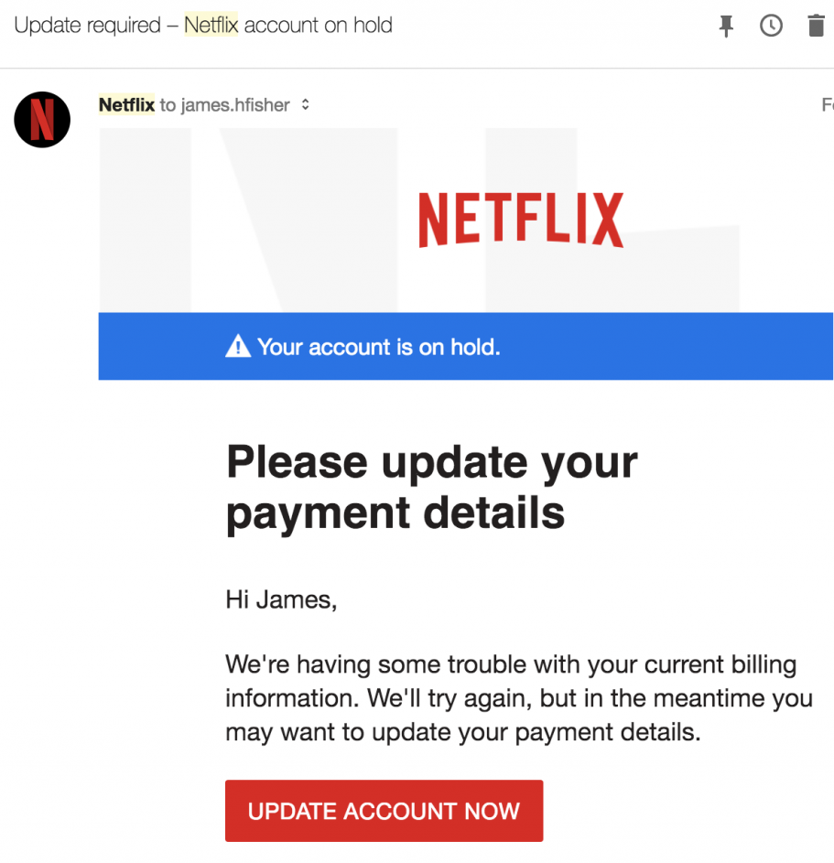
Phishing
Attackers trick victims into providing sensitive information or visiting malicious URLs in the attempt to compromise their systems.
Victims may disclose sensitive data.

Slide 5



Tailgating
An attacker seeks entry to a restricted area in which they lack the proper authentication.
They follow a person who is authorized to access the area.

Slide 6
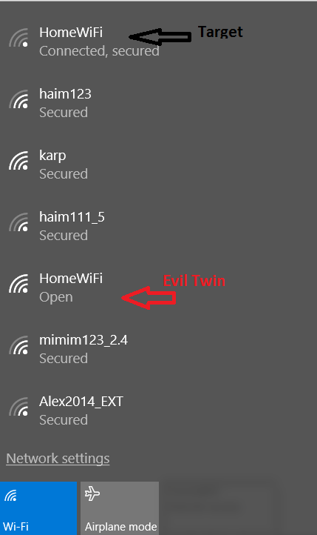

Evil Twin Access Points
Target Network
Attackers create an SSID that matches a network a company or individual is already familiar with.
With time, someone is likely to mistakenly connect to the open network.
Evil Twin

Slide 7


Baiting
A user is enticed with a downloadable file or flash drive that is labeled with something they want to see.
Once the bait is downloaded, malicious software allows an attacker to exploit the user’s system.

Slide 8
How to prevent attacks?
Proper Training
Stronger Network Credentials

Slide 9
References
Heinbach, Courtney. “5 Types of Social Engineering Attacks.” Datto, 11 Aug.
2020, www.datto.com/blog/5-types-of-social-engineering-attacks.
Paganini, Pierluigi. “The Most Common Social Engineering Attacks [Updated
2020].” InfoSec, 6 Aug. 2020, resources.infosecinstitute.com/common-social-engineering-attacks/.
Shabi, Tal. “No One Is Safe: the Five Most Popular Social Engineering
Attacks Against Your Company's Wi-Fi Network: Imperva.” Imperva, 21 Feb. 2019, www.imperva.com/blog/no-one-is-safe-the-five-most-popular-social-engineering-attacks-against-your-companys-wi-fi-network/.

